Slide 1
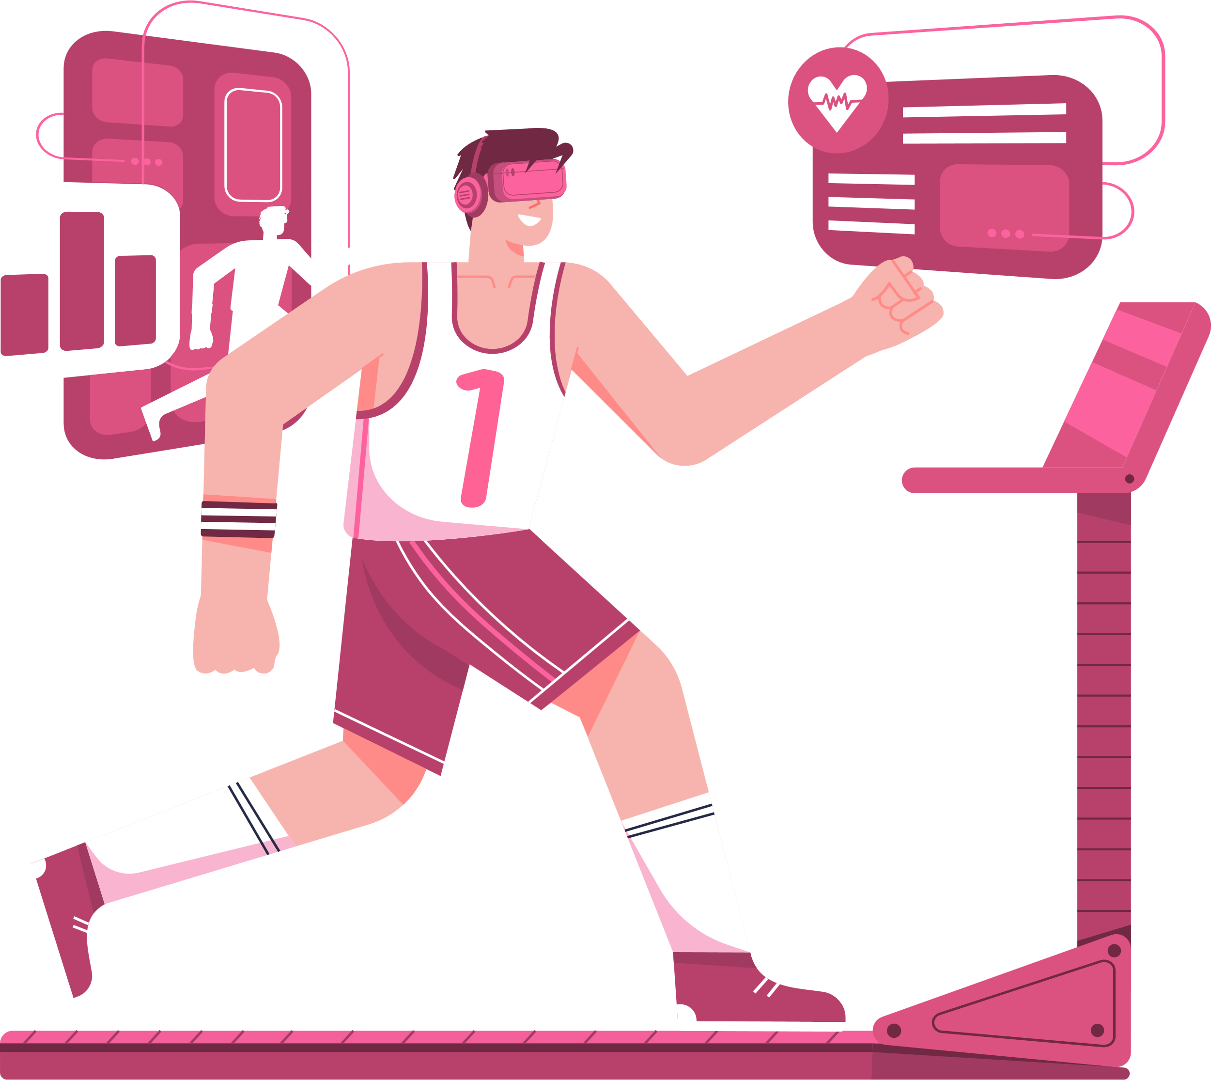
STRAVA
FITNESS
LET'S TALK ABOUT DATA PRIVACY

Slide 2
UX / SECURITY
Create trust amongst users by informing them about the data points collected and their uses
INFO
UX
SECURITY
Collecting too many data points might antagonize users vary about data collection
Focusing on security might score some brownie points, but will render the app a glorified fitness tracker
Notes:
While as an application, we should always look to give a better User Experience, looking at the current climate regarding data security it would be highly beneficial to use it to our advantage. Anonymizing data while informing users about the collected data and how we are using the data would go a long way in ensuring trust in our application. We should also provide options to the users to either wipe their data and / or retrieve their data whenever required.

Slide 3









DATA POINTS
IDENTIFIERS
NON-IDENTIFIERS
NAME
ADDRESS
MUSCLE WEIGHT
PAST/CURRENT
WORKOUT PLAN
BIRTH MONTH
+
AGE (BIN)
WEIGHT
HEIGHT
CALORIC INTAKE
FITNESS GOALS
Notes:
These are the data points that I think the app should store. The name and address should be anonymized within our models. The Birth Month + Age (bin) will allow for us to have a decent estimate of the age of the user without required to collect the date of birth, which in a breach could be harmful. The rest of the data points do not have to be anonymized.

